Slide 1

WAY TO ENTERPRISE
AWS
VTI ACADEMY
Author: duy.nguyenngoc1@vti.com.vn

Slide 2
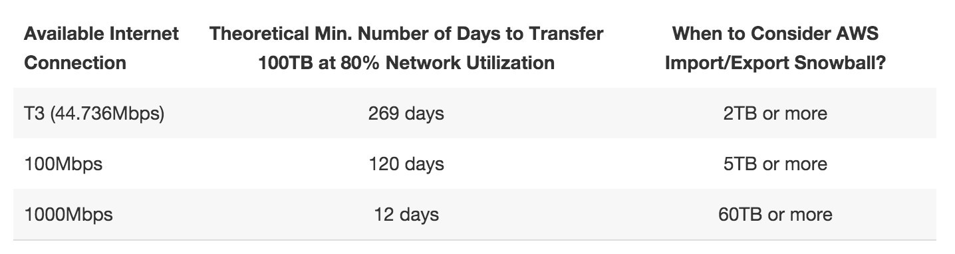
Snow Family Service
Using for transfer large amount of data between on-premises and S3
Highly-secure, portable devices
Transfer faster, cheaper than over the internet
Transfer data from several TB
https://docs.aws.amazon.com/snowball

Slide 3
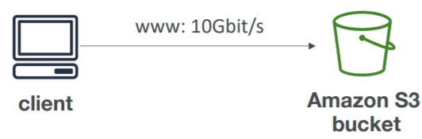
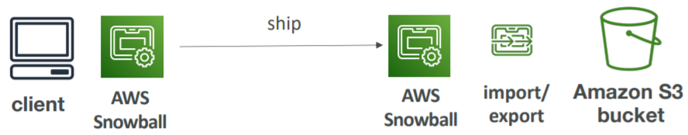
Snow Family Service
Usecases
  Import/export large amount of data (from several TB) between on-premises and S3
  Use device as local storage
  DC decommission, disaster recovery
Price: https://aws.amazon.com/snowball/pricing
Direct upload to S3
Snow Family
If it takes more than a week to transfer over the internet, use Snowball devices!

Slide 4
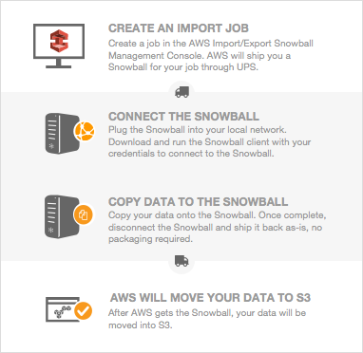
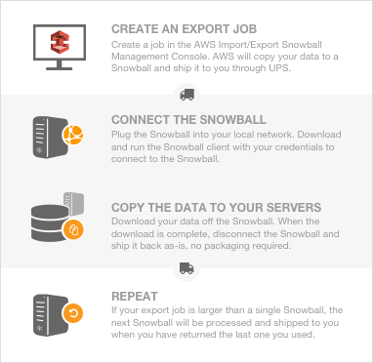
Snow Family Service
Flow
Import
Export
https://docs.aws.amazon.com/snowball/latest/ug/how-it-works.html

Slide 5
Snow Family Service
  Step 1: Request Snowball devices from the AWS console for delivery
  Step 2: Install the snowball client / AWS OpsHub on your servers
  Step 3: Connect the snowball to your servers and copy files using the client
  Step 4: Ship back the device when you’re done (goes to the right AWS facility)
  Step 5: Data will be loaded into an S3 bucket
  Step 6: Snowball is completely wiped

Slide 6
Snow Family Service
Components
  Snowball devices
  Snowball client / S3 Adapter for Snowball
  OpsHub / Snowball Edge client

Slide 7
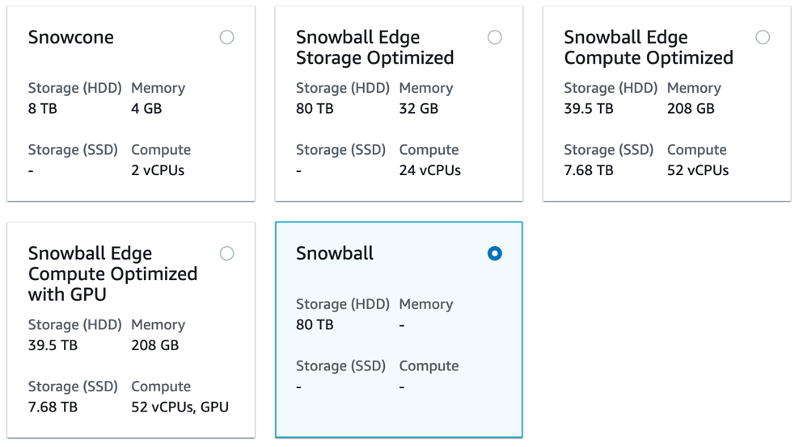
Snow Family Service
  Snowball device
    Is a physical storage device
    Shipped through Shipping Regional Carriers
    Types
      Snowcone
      Snowball Edge
      Snowmobile

Slide 8
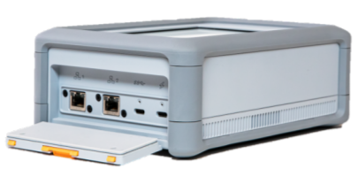
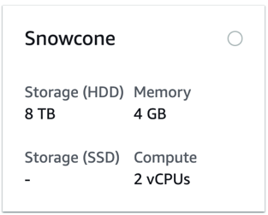
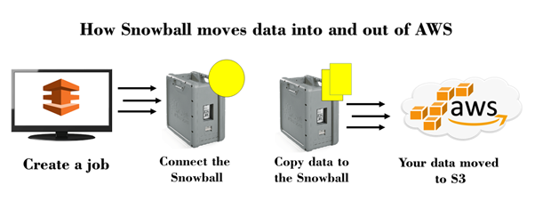
Snow Family Service
      Snowcone
        Small, portable computing, anywhere, rugged & secure, withstands harsh environments
        Light: 2.1 kg
        Can be sent back to AWS offline, or connect it to internet and use AWS DataSync to send data
        Price: https://aws.amazon.com/snowcone/pricing

Slide 9
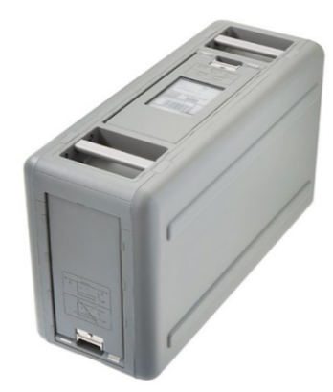
Snow Family Service
      Snowball Edge
        Light: 22.54 kg
        Faster than snowcone, up to 100GB/s
        Providing Processing Data Tool (Lambda Function)
          Preprocess data, Transcoding media streams,
          Connect to existing system
            Example: An Aircraft engine manufacturer can put a Snowball edge on an Airplane to collect information about how the plane's engines are running. When the Plane lands, getting the Snowball edge from the Airplane and send it to the AWS Data Center
          Support cluster
            Can combine Snowballs, local data in on-premises into 1 cluster to provide storage so that the application can run without internet

Slide 10
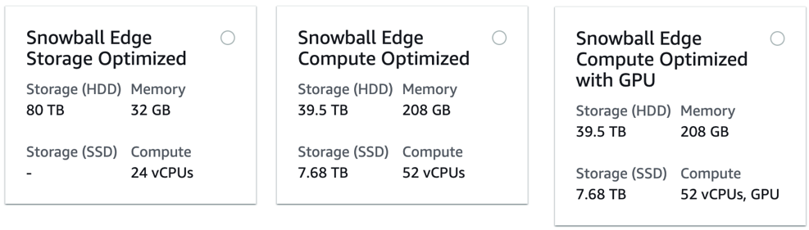
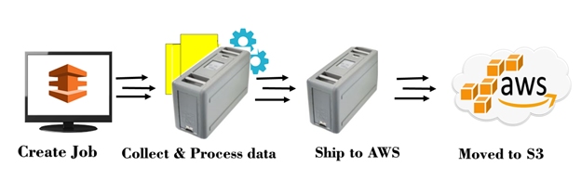
Snow Family Service
        Price: https://aws.amazon.com/snowball/pricing
        Types:
          Storage Optimized (for data transfer)
          Compute Optimized
          Compute Optimized with GPU
https://docs.aws.amazon.com/snowball/latest/developer-guide/device-differences.html

Slide 11
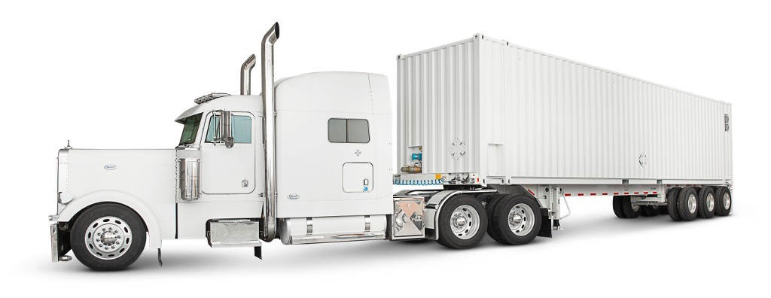
Snow Family Service
      Snowball Mobile
        Transfer exabytes of data (1 EB = 1,000 PBs = 1,000,000 TBs)
        Each Snowmobile has 100 PB of capacity (use multiple in parallel)
        High security: temperature controlled, GPS, 24/7 video surveillance
        Usecases
          Better than Snowball if you transfer more than 10 PB
          Transfer video libraries, image repositories, ...

Slide 12
Snow Family Service
  Snowball client / S3 Adapter for Snowball
    Is a Software installed on Snowball Device to transfer data between Snowball device and on-premises workstation
    Snowball client: using via UI
    S3 Adapter for Snowball: using via API, SDK, CLI

Slide 13
Snow Family Service
  OpsHub / Snowball Edge client
    Is a software which you install on your computer to manage your Snow Family Device
    Tasks:
      Unlocking and configuring single or clustered devices
      Transferring files
      Launching and managing instances running on Snow Family Devices
      Monitor device metrics (storage capacity, active instances on your device)
      Launch compatible AWS services on your devices (ex: Amazon EC2 instances, AWS DataSync, Network File System (NFS))

Slide 14
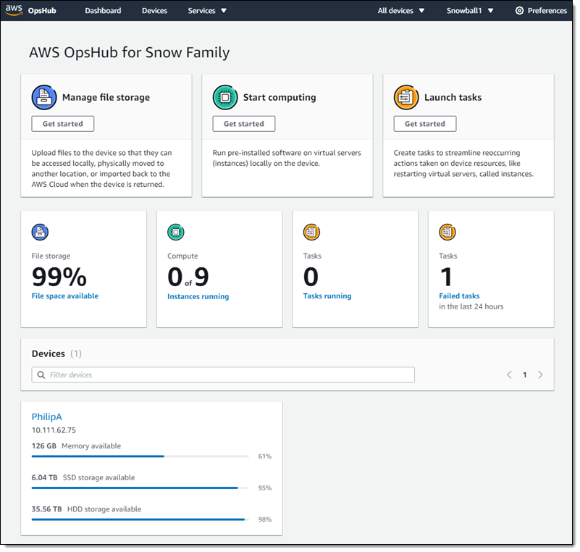
Snow Family Service
https://www.youtube.com/watch?v=_A3A47Vuu0I

Slide 15
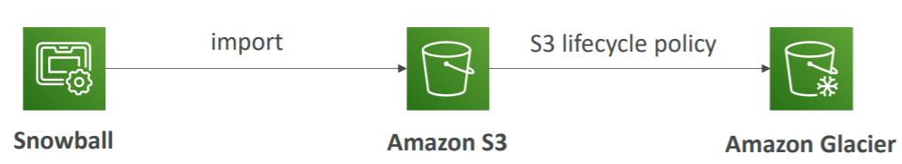
Snow Family Service
Snowball into Glacier
  Snowball cannot import to Glacier directly, you must use Amazon S3 first, in combination with an S3 lifecycle policy

Slide 16
Assignment
  Self-practice

Slide 17
Storage Comparison
  S3: Object Storage
  Glacier: Object Archival
  EBS volumes: Network storage for one EC2 instance at a time
  Instance Storage: Physical storage for your EC2 instance (high IOPS)
  EFS: Network File System for Linux instances
  FSx for Windows: Network File System for Windows servers
  FSx for Lustre: High Performance Computing Linux file system
  Storage Gateway: File Gateway, Volume Gateway (cache & stored), Tape Gateway
  Snowball: To move large amount of data to the cloud (physically)

Slide 18
Assignment

Slide 19
Quiz

Slide 20
Reference
https://docs.aws.amazon.com/

Slide 21
Q & A
Copyright © VTI Academy All Rights Reserved

